Slide 1

Exploration under Function Approximation
Notes:
1

Slide 2
Objectives
Describe how optimistic initial values can be used with function approximation
Understand how Epsilon greedy can be used with function approximation
Exploration under Function Approximation
2
Notes:
2

Slide 3
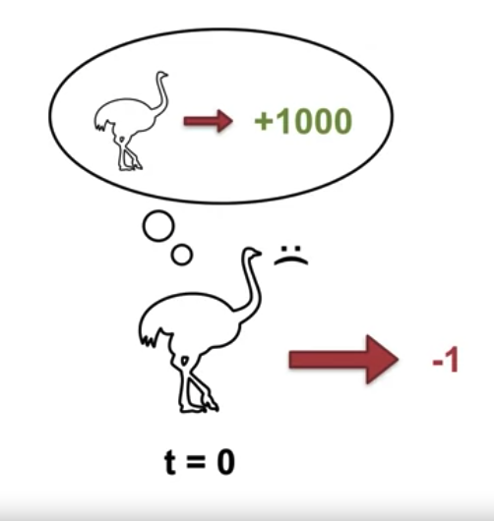
Optimistic Initial Values in the Tabular
We initialize our values to be greater than the true values.
This is like the agent imagining that it can get more reward by taking that action than it actually can in reality.
Exploration under Function Approximation
3
Notes:
3

Slide 4
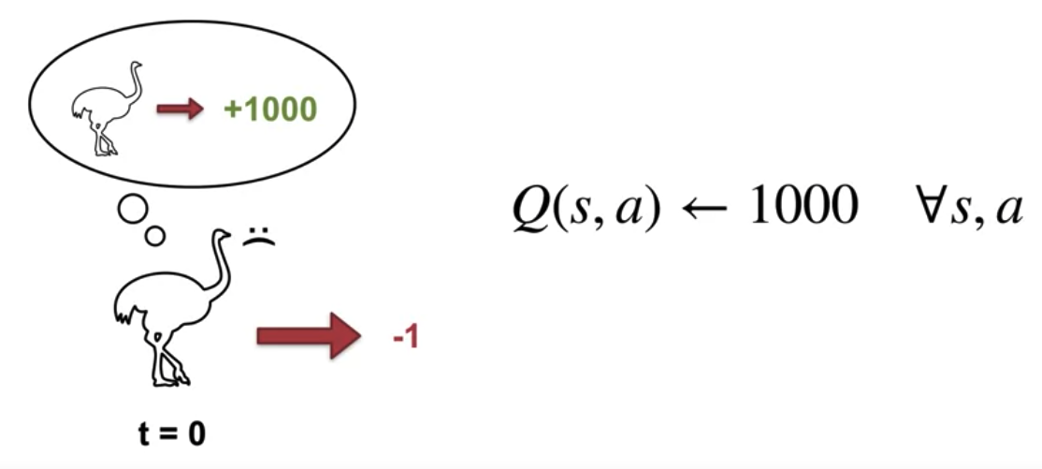
Optimistic Initial Values in the Tabular
This is straightforward to implement in a tabular setting where the update to each state action pair is independent of all the other state action pairs
Exploration under Function Approximation
4
Notes:
4

Slide 5
Optimistic Initial Values in the Tabular
How to initialize values optimistically under function approximation:
In function approximation, optimistic initial values corresponds to initializing the weights such that the resulting values are optimistic.
In some cases this is straightforward, for example, when the features are binary, we simply initialize each weight to be the largest possible return.
Then, as long as each state has at least one feature active, the value will be optimistic and likely overly so.
Exploration under Function Approximation
5
Notes:
5

Slide 6
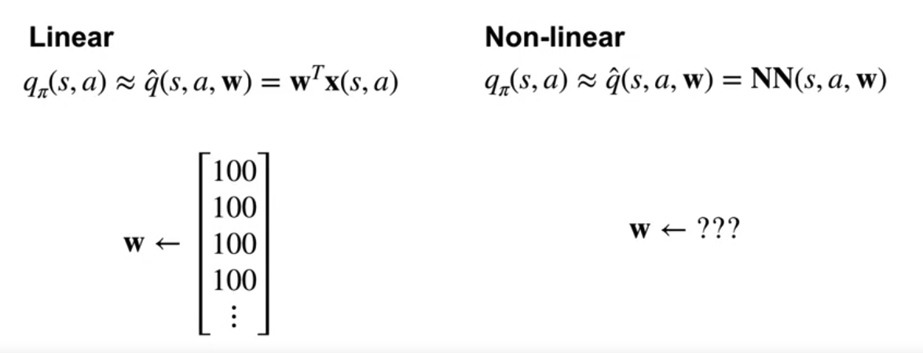
Optimistic Initial Values in the Tabular
How to initialize values optimistically under function approximation:
Non-linear: the relationship between the final values and the features can be quite complicated.
Exploration under Function Approximation
6
Notes:
6

Slide 7
Optimistic Initial Values in the Tabular
Depending on how our features generalize, optimistic initial values may not result in the same kind of systematic exploration we see in the tabular case.
Consider an extreme example, where we have only one feature that is always one.
We can initialize optimistically but every update will change the value for all states.
This means that before some states are even visited, the value will already have decreased such that it is no longer optimistic.
Exploration under Function Approximation
7
Notes:
7

Slide 8
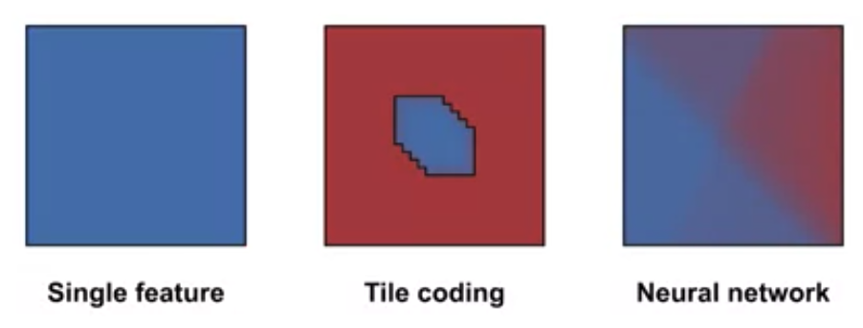
Optimistic Initial Values in the Tabular
Function approximation with tile coding can produce such localized updates.
Neural networks and also provide local updates, but neural networks may also generalize aggressively.
Exploration under Function Approximation
8
Notes:
8

Slide 9
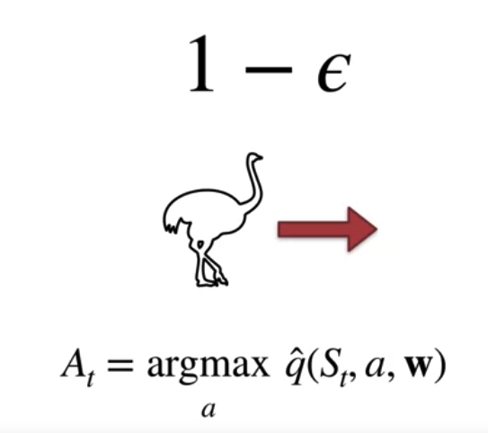
Epsilon Greedy
Epsilon greedy is generally applicable and easy to use even in cases with non-linear function approximation.
The only thing Epsilon greedy needs are the action value estimates, independent of how they are initialized or approximated.
Exploration under Function Approximation
9
Notes:
9

Slide 10
Epsilon Greedy
However, Epsilon greedy is not a directed exploration method.
It relies on randomness to discover better actions near states followed by the current policy.
It is therefore not as systematic as exploration methods that rely on optimism.
Exploration under Function Approximation
10
Notes:
10

Slide 11
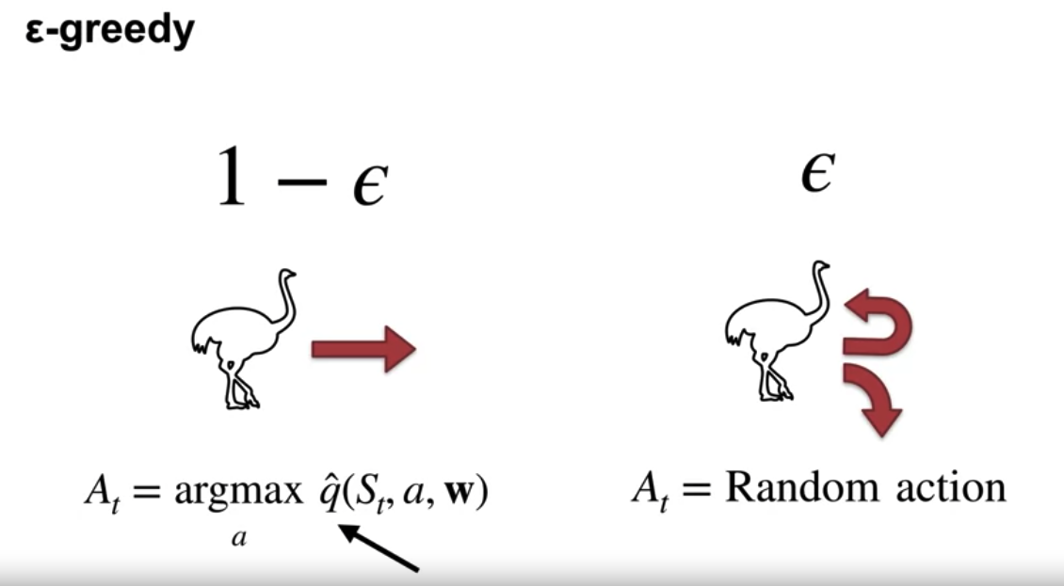
Epsilon Greedy
Exploration under Function Approximation
11
Notes:
11

Slide 12
Summary
Describe how optimistic initial values can be used with function approximation
Understand how Epsilon greedy can be used with function approximation
Exploration under Function Approximation
12

Slide 13
Q & A
Exploration under Function Approximation
13

